Slide 1
Secure Service Fabric with AAD

Slide 2
Steps
Setup of your cluster certificate
Setup of Azure AD
Azure Cluster creation
Testing your Admin and Read-only user login

Slide 3
Setup KV
Run the Create-CertAndKV.ps1 file
Record the tenanted and subscription id. They are needed in following steps

Slide 4
Setup AAD
To secure the cluster with Azure AD, you will need to decide which AD directory in your subscription you will be using. In this example, we will use the ‘default’ directory. In the previous step, you should have recorded the ‘tenantID’. This is the ID associated with your default Active directory.
NOTE: If you have more than one directory (or tenant) in your subscription, you are going to have to make sure you get the right tenantID from your AAD administrator. The first piece of script you need to save to a file named common.ps1. The second is Create-Applications.ps1

Slide 5
Then
Modify Setup-Applications2.ps1 with your cluster information
Run that script
This creates the application and service principle in AAD

Slide 6
NOTE
The ClusterName is used to prefix the AAD applications created by the script. It does not need to match the actual cluster name exactly as it is only intended to make it easier for you to map AAD artifacts to the Service Fabric cluster that they’re being used with. This can be a bit confusing because you haven’t created your cluster yet. But, if you know what name you plan to give your cluster, you can use it here

Slide 7
Callback for OAuth
The WebApplicationReplyUrl is the default endpoint that AAD returns to your users after completing the sign-in process. You should set this to the Service Fabric Explorer endpoint for your cluster, which by default is
https://<cluster_domain>:19080/Explorer

Slide 8
Record the output
It will look like, and is needed later in the portal:
“azureActiveDirectory”: {
“tenantId”:”<Your-AAD-tenantID>”,
“clusterApplication”:”1xxxxxxxx-x68e-490a-89c8-2894e4b8686a”,
“clientApplication”:”xxxxxxx-7825-4e1e-a586-f0ff8d9e679e”

Slide 9
Now we have to use classic portal
https://manage.windowsazure.com/

Slide 10
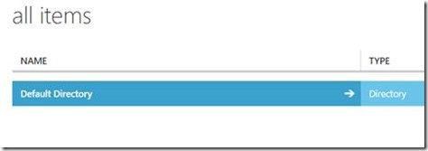
Look up your AD

Slide 11
Add 2 new Users to your AAD
Name them whatever you want just as long as you know which one is Admin and which one would be the read-only user. Make sure to record the password that is initially generated, because the first time you try to log in to the portal as this user, you will be asked to change the password.
Or just use 2 existing users

Slide 12

Find Your App
Within your AAD, click on the Applications menu. In the Show drop-down box, pick Applications My Company Owns and then click on the check button over to the right to do a search.

Slide 13
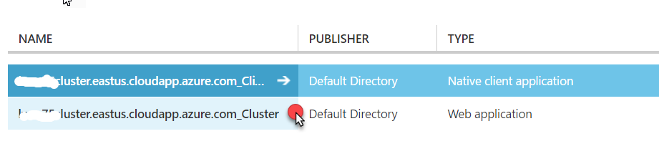
Configure SF Explorer for Auth
You should see two applications listed. One will be for Native client applications and the other for Web Applications. Click on the application name for the web application type. Since we will be doing our connectivity test connecting to the Service Fabric Explorer web UI, this is the application we need to set the user permissions on.

Slide 14
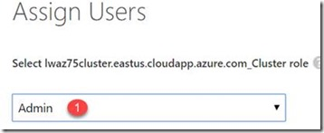
Assign Users
Click on the Users menu.
Click on the user name that should be the administrator and then select the Assign button at the bottom of the portal Window.
In the Assign Users dialog box, pick Admin from the dropdown box and select the check button.

Slide 15
Now a second user
Repeat for the read-only user. Select Read-only from the Assign Users drop-down. This step completes what you will need to do in the classic portal, so you can close the classic portal window.
You now have all the information you need to create your cluster in the portal. Log in to the Azure Portal at https://portal.azure.com.

Slide 16
Create SF Cluster
Create a new resource group and then within the resource group start the process of adding a new Service Fabric Cluster to the resource group. As you are stepping through creating the cluster, you will find 4 core blades with information you need to provide:
Basic – unique name for the cluster, operating system, username/password for RDP access etc.
Cluster configuration – node type count, node configuration, diagnostics etc.
Security – This is where we want to focus in the next step….
In the cluster Security blade, make sure the Security mode is set to Secure. It is by default.

Slide 17
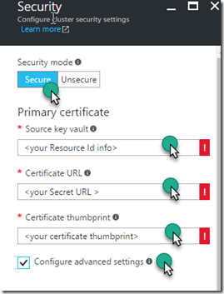
The output from the first PS script you executed will contain the information you need for the Primary certificate information. After you enter your recorded information, make sure to select the Configure advanced settings checkbox.

Slide 18
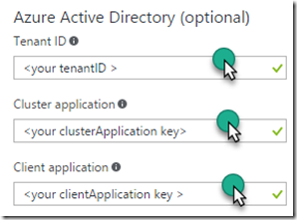
By selecting the Configure advanced settings checkbox, the blade will expand (vertically) and you can scroll down in the blade to find the area where you need to enter the Active Directory information. The information you recorded when you executed SetupApplications.ps1 will be used here.

Slide 19
Select the Ok button in the Security blade.
Complete the Summary blade after the portal validates your settings.

Slide 20
Testing Admin and Read Only Access
Once the cluster has completed the creation process, make sure you log out of the Azure portal. This assures that when you attempt to log in as the Admin or Read-only user, you will not accidentally log in to the portal as the subscription administrator.
Log in to the portal as either the Admin or Read-only user. You will need to change the temporary password you were provided early and then the log in will complete.
Open up a new browser window and log in to https://<yourfullclustername>:19080/Explorer/. Test the Explorer functionality.

